Slide 1


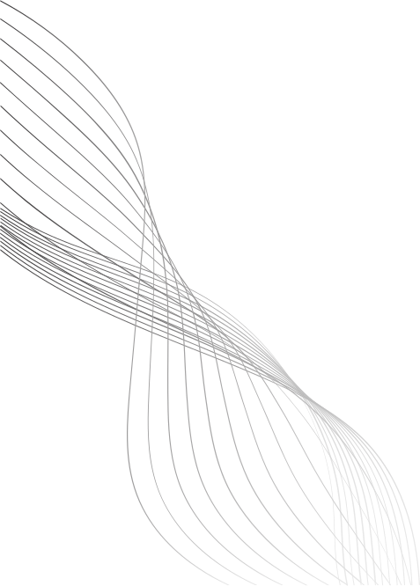
DEPARTMENT OF DATASCIENCE
DETECTING LUNG CANCER IN ITS EARLY STAGE USING DEEP LEARNING - TRANSUNET
BATCH - A03
GUIDE : DR. V. RAMESH BABU
PRESENTED BY,
M AKASH KRISHNAN - 221191101006
J DHANESH - 221191101035

Slide 2
LITRERATURE SURVEY
Year | Paper Title | Problem Statement | Proposed Solution | Research Gap
2025 | A hybrid CNN-transformer model for predicting N staging and prognosis of NSCLC | Accuracy problems arise due to the difference of specializations of the models. | Analyzes 80+ models for detection and segmentation using CT data. | Emphasizes need for unified, interpretable systems like TransUNet; no benchmarked comparisons yet available.
2024 | Dual-branch feature fusion S3D V-Net network for lung nodules segmentation | Poor generalization and black-box behavior limit clinical trust in AI models. | Reviews multimodal and attention-driven models for early-stage lung cancer detection. | Explainable segmentation + classification models like TransUNet are missing; no visual AI support discussed.
02

Slide 3
LITRERATURE SURVEY
Year | Paper Title | Problem Statement | Proposed Solution | Research Gap
2024 | A multi-task model for pulmonary nodule segmentation and classification | Separate handling of segmentation and classification limits system efficiency. | Surveys models across all three stages: detection, segmentation, and classification. | Few models perform end-to-end dual tasks with interpretability; no detailed TransUNet integration.
2023 | Fusion networks of CNN and transformer with channel attention for lung nodule detection | CNNs lack long-range context for precise nodule detection in CT scans. | Explores Vision Transformers (ViT, Swin) for classification and attention learning in lung CTs. | No unified segmentation-classification pipeline; hybrid models like TransUNet are not explored.
2023 | Accurate classification of lung nodules on CT images using the TransUnet | Manual CT analysis is time-consuming and inconsistent, delaying diagnosis. | Reviews CNN/U-Net-based models for lung cancer segmentation and classification. | Lacks coverage of Transformer-CNN hybrids like TransUNet; segmentation and classification not integrated.
03

Slide 4
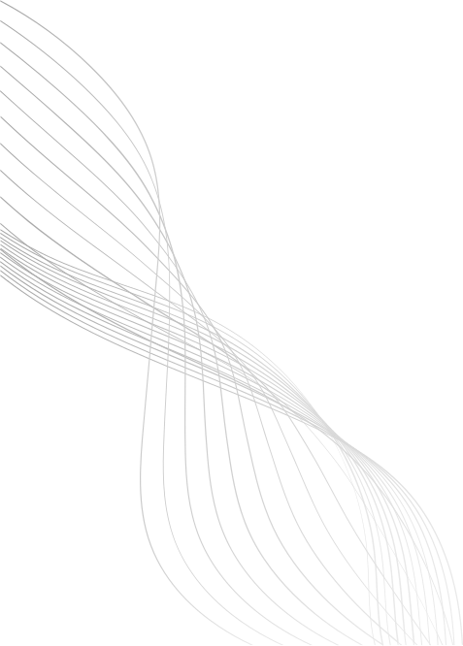
PROBLEM STATEMENT
Lung cancer is the leading cause of cancer-related deaths, largely due to late-stage diagnosis.
Although 3D CT scans are effective for early detection, manual interpretation of massive spatial volumes is slow, prone to cognitive fatigue, and varies between radiologists.
Existing AI models often struggle with either fine-grained local texture analysis or the global contextual understanding needed for highly accurate diagnosis.
There's a lack of explainable, multi-modal ensemble models—combining CNNs, ResNets, and Vision Transformers—that can perform both pixel-perfect segmentation and precise classification of lung nodules in a clinically meaningful way.
A robust, automated, and interpretable clinical dashboard is needed to assist radiologists in detecting early-stage lung cancer with high baseline precision, rapid computational speed, and absolute diagnostic transparency.
04

Slide 5

EXISTING SYSTEM
Traditional diagnosis of lung cancer relies on manual evaluation of massive volumetric CT scans by radiologists, which is time-intensive and prone to human error.
Conventional machine learning models require hand-crafted features and lack the ability to automatically extract deep, complex spatial hierarchies and edge morphology across diverse patient data.
Standard 2D and 3D CNN-based segmentation models (like U-Net) can detect lung nodules but often fail to capture the global context and long-range dependencies that Vision Transformers (ViTs) successfully resolve.
Classification and segmentation are often handled separately, leading to disjointed pipelines and a lack of unified, dual-task ensemble models that can simultaneously predict malignancy and generate pixel-perfect boundary masks.
Few existing systems provide visual explanations or trustworthy AI outputs, creating a critical need for an interpretable clinical dashboard that delivers multi-planar reconstructions, exact segmentation overlays, and sensible confidence scaling for radiologists.
05

Slide 6
REQUIREMENT ANALYSIS
SOFTWARE & HARDWARE REQUIREMENTS:
High performance multiple cloud Gpu’s
powerful cloud Gpu (higher end Gpu) are needed to run the model since the Transunet model consume system resource compared to other models.
Storage for multiple large datasets
Since the model needs heavy system resource, a manageable storage enough to stack up the datasets that is required to train the model.
06

Slide 7
DESIGN METHODOLOGY
Data Collection: The globally recognized LUNA16 dataset will be used, utilizing massive 3D CT scans (.mhd format) and precise coordinate mapping via metadata.
Preprocessing: World-to-voxel coordinate translation via SimpleITK, extraction of highly localized 16x64x64 3D patches, and zero-mean/unit-variance normalization.
Segmentation: Generation of pixel-perfect boundary masks utilizing the TransUNet's Vision Transformers and UNet decoder, enhanced by cross-network skip connections.
Classification: Processing the localized patches through the Ensemble method (TransUNet, SimpleCNN, and ResNet-18) unified by a dense Fusion Gate for exact malignancy prediction.
Evaluation: Rigorous baseline evaluation of the SCRATCH_FINAL model using critical clinical metrics such as Accuracy, ROC-AUC, Precision, Recall (Sensitivity), and Mean Dice Score.
Explainability: Deployment via a Streamlit clinical dashboard featuring Multi-Planar Reconstructions (axial, coronal, sagittal) and direct segmentation mask overlays to visually prove the AI's diagnostic focus.
07

Slide 8
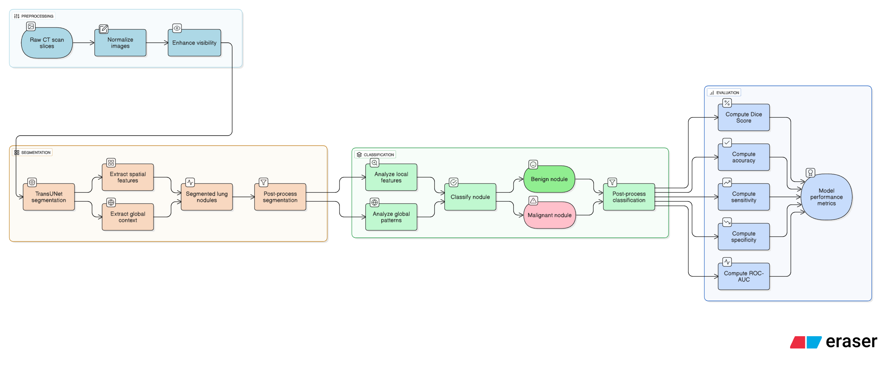

ARCHITECTURE OF PROPOSED SYSTEM
08

Slide 9
MODULES OF PROPOSED SYSTEM
Phase 1: Data Collection & Preprocessing – (Week 1 - 2)
Gather CT scan datasets (e.g., LIDC-IDRI and other public sources) and curate them into training, validation, and testing sets.
Apply preprocessing steps like normalization, resizing and segmentation of lung regions to ensure data consistency.
Phase 2: Model building & Evaluation – (Week 3 – 6)
Implement TransUNet to leverage both CNN and Transformer encoders for accurate lung nodule segmentation and cancer classification.
Evaluate both models using metrics such as Dice score (for segmentation), accuracy, precision, recall, F1-score, and ROC-AUC (for classification).
Phase 3: Explainability Integration with Grad-CAM – (Week 7 – 8)
Integrate Grad-CAM to visualize attention maps from the Transformer layers, showing critical regions influencing predictions.
Validate explanations by comparing attention maps with expert radiologist annotations for interpretability and trust.
Phase 4: Documentation & Preparation – (Week 9 – 10)
Compile results, visualizations (segmentation masks, attention maps, Grad-CAM outputs), and performance comparisons into well-structured documentation.
Prepare reports, presentations, and possible Conference material for academic or professional submission.
09

Slide 10
TECHNOLOGIES TO BE USED IN PROPOSED SYSTEM
Preprocessing of CT Scans: CT scan slices are normalized and enhanced to improve visibility of potential lung nodules for downstream processing.
Lung Nodule Segmentation using TransUNet: A hybrid ensemble model is used to perform accurate semantic segmentation, combining the spatial precision of U-Net structures with the global context learning of Transformers.
Nodule Classification: The segmented region is classified as benign or malignant by analyzing both fine-grained local features and global patterns learned from the image.
Model Evaluation: The system is evaluated using metrics such as Dice Score (for segmentation), and Accuracy, Sensitivity, Specificity, and ROC-AUC (for classification).
Clinical Decision Support: The system provides visual and interpretable outputs to support radiologists in early diagnosis, ensuring faster and more consistent clinical decisions.
10

Slide 11
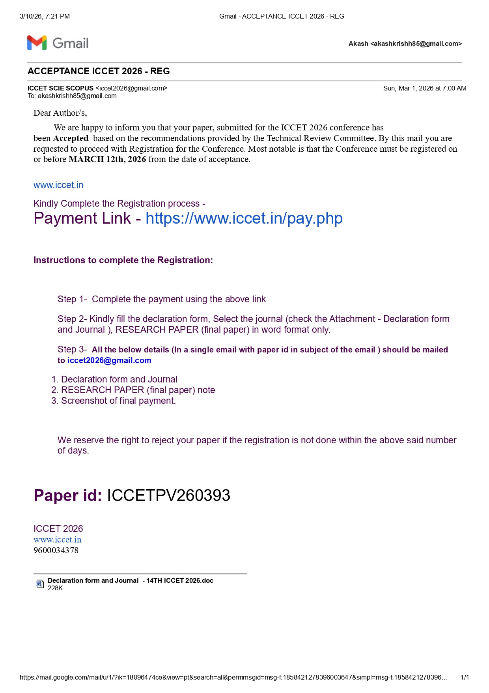
PAPER PUBLICATION
Submitted a research paper to the International Conference on Computer Engineering and Technology (ICCET 2026), which has been successfully accepted for presentation/publication.
Submitted another research paper to the International Conference on Computational Intelligence, Security and Systems (ICCISS’26) at Sona College of Technology, Salem, scheduled for March 13–14, 2026
10

